Slide 1
VSocial
A Social Media Platform For All

Slide 2
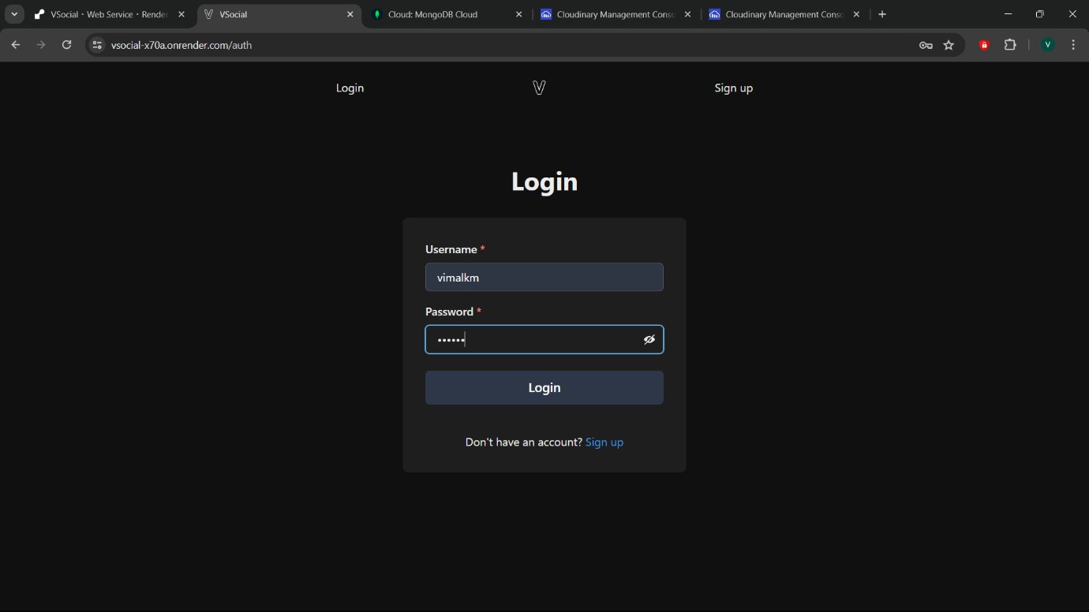
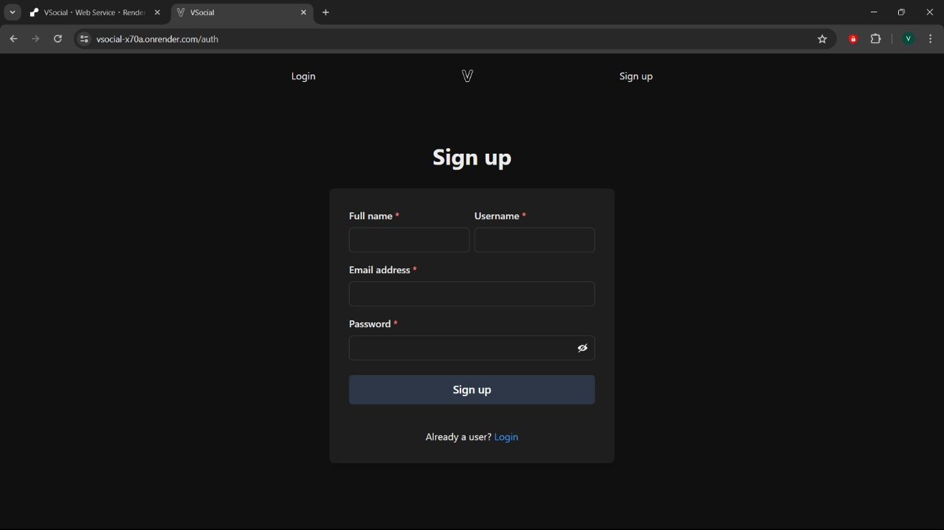
1. Login Page
2. Signup Page
3. Home Page

Slide 3
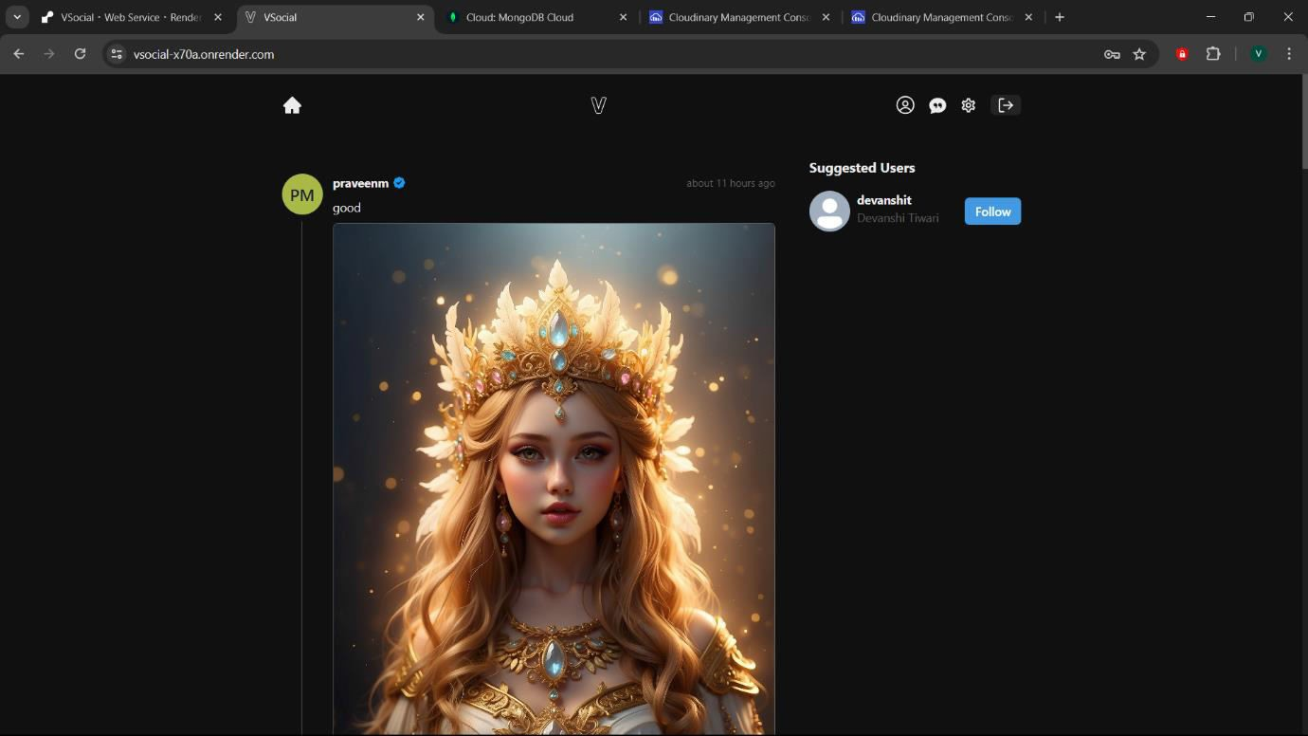
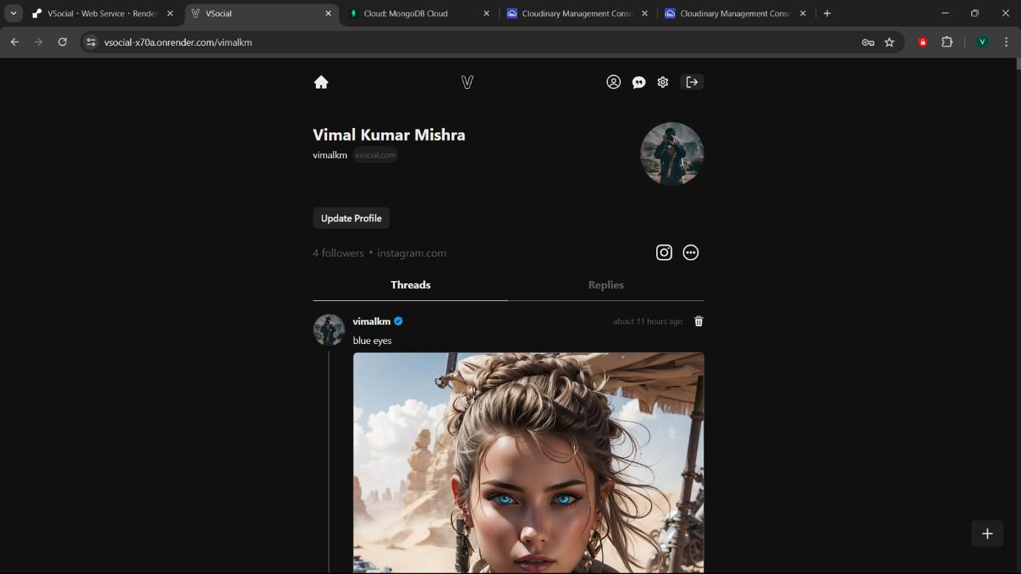
4. Account Page
5. Update Profile Page

Slide 4
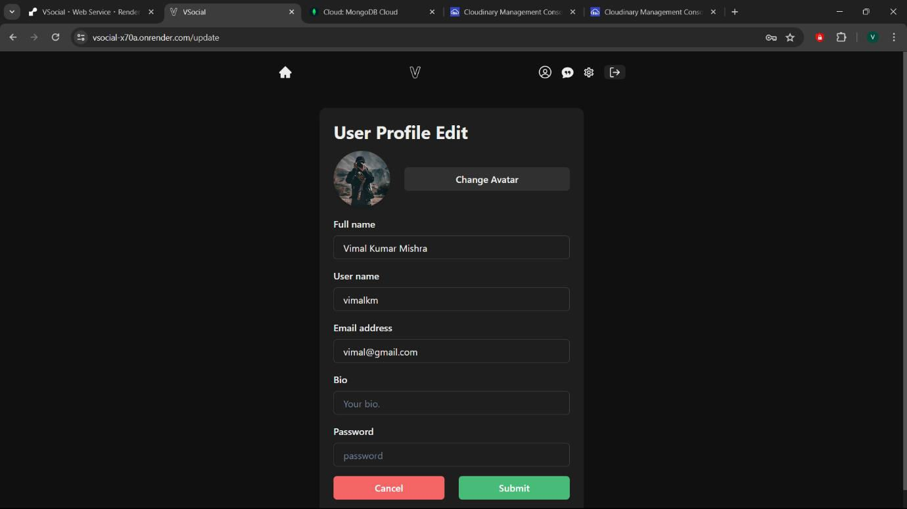
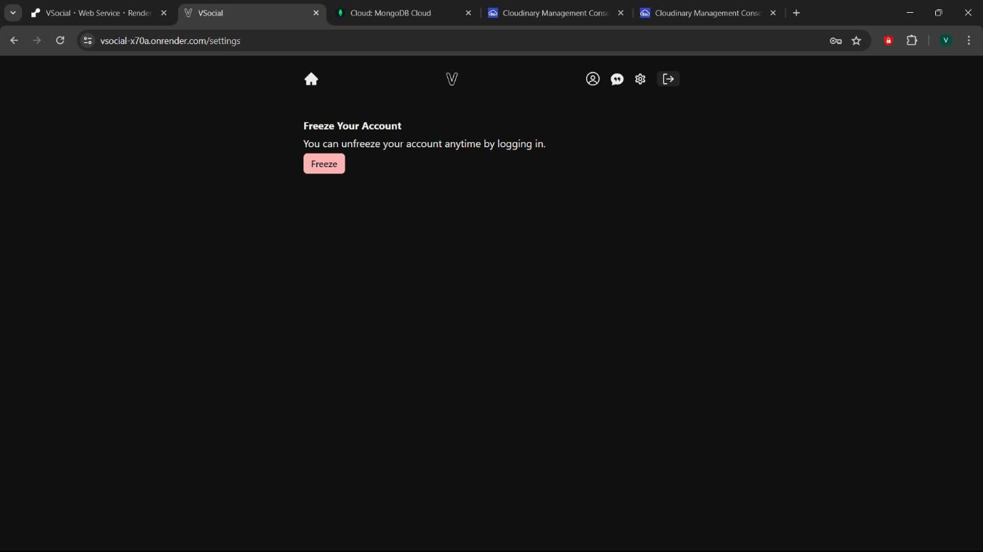
6. Setting Page
7. Chat Page

Slide 5
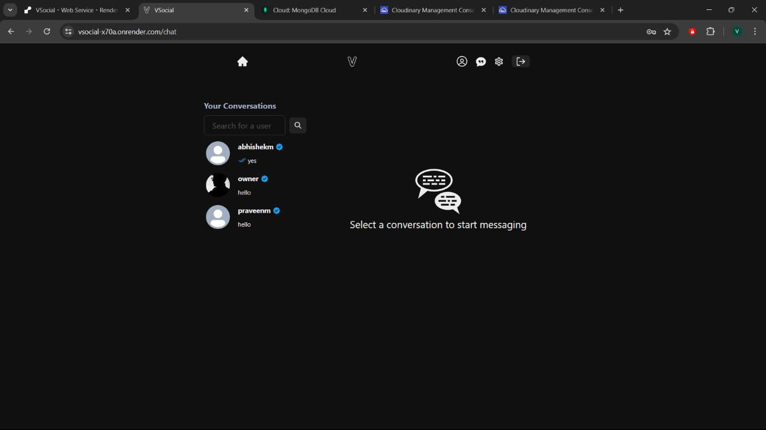
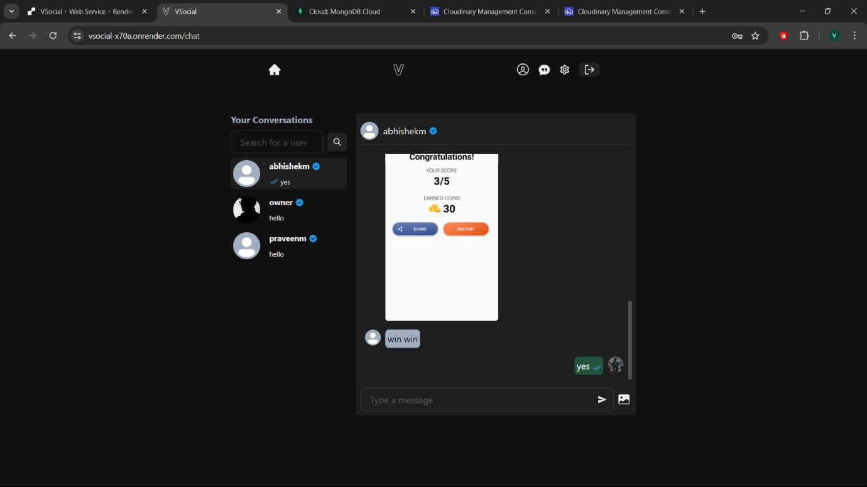
8. Light Theme

Slide 6
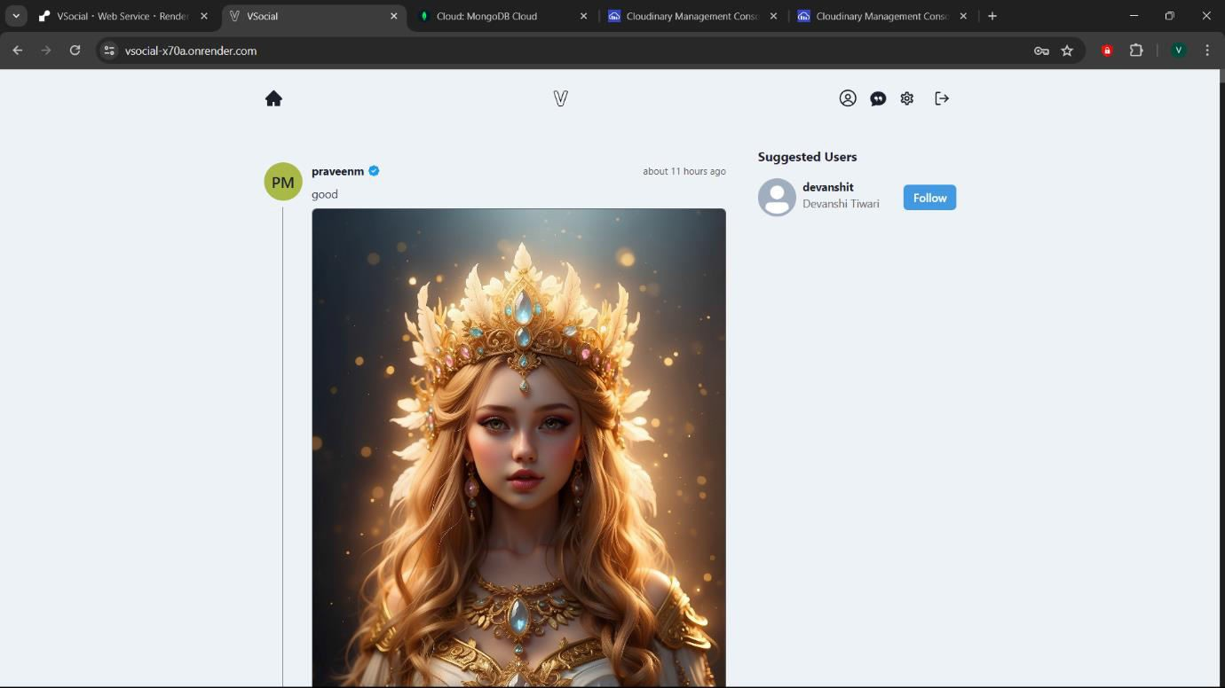
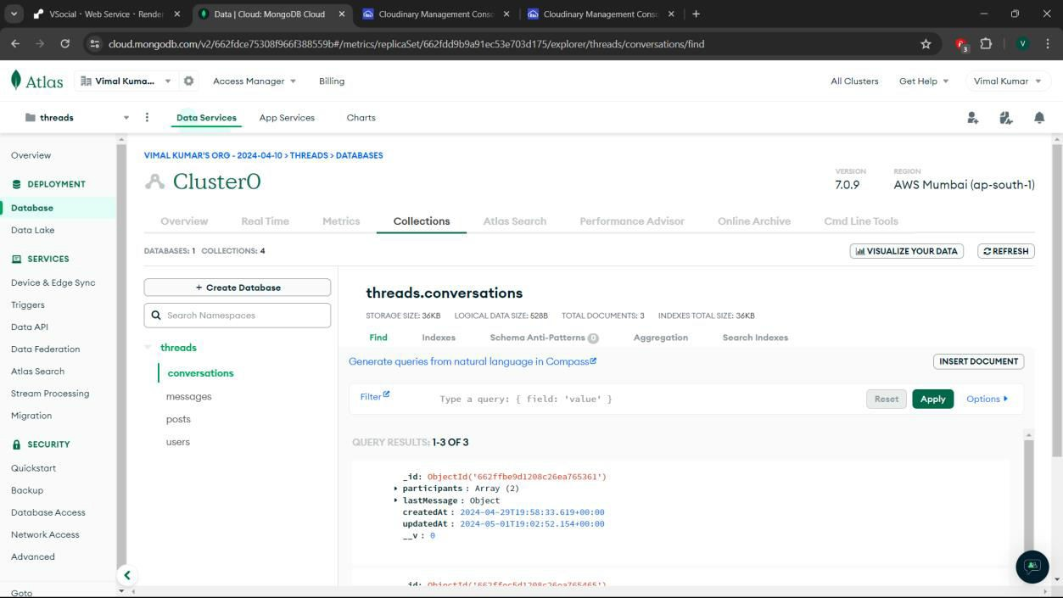
9. MongoDB Used for Storing Messages & Chats
10. Cloudinary Used for Storing Images

Slide 7
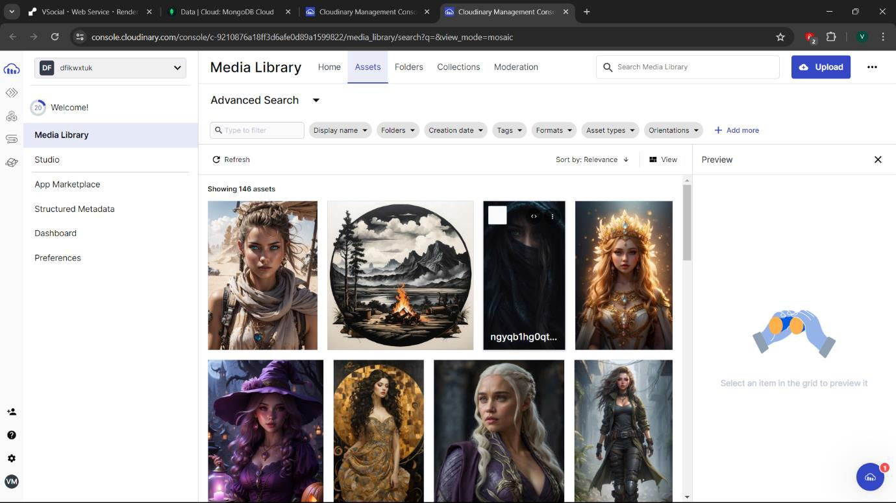
REFERENCE
REFERENCE: Google, YouTube, etc.
GITHUB LINK
LINK: https://github.com/VimalKMGithub/VSocial
ONLINE APP LINK
LINK: https://vsocial-x70a.onrender.com

